Slide 1
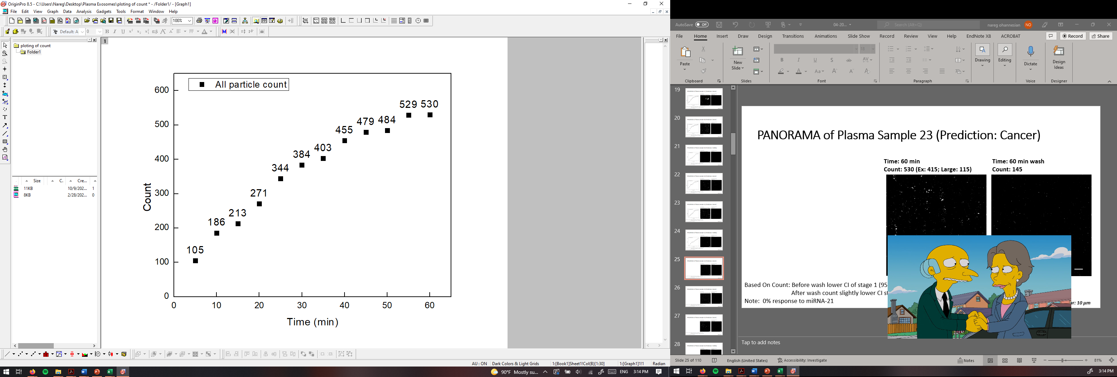
PANORAMA of Plasma Sample 23 (Prediction: Cancer)
Time: 60 min
Count: 530 (Ex: 415; Large: 115)
Time: 60 min wash
Count: 145
Based On Count: Before wash lower CI of stage 1 (950-1558)
After wash count slightly lower CI stage 1 (151-370)
Note: 0% response to miRNA-21
Scale bar: 10 µm

Slide 2
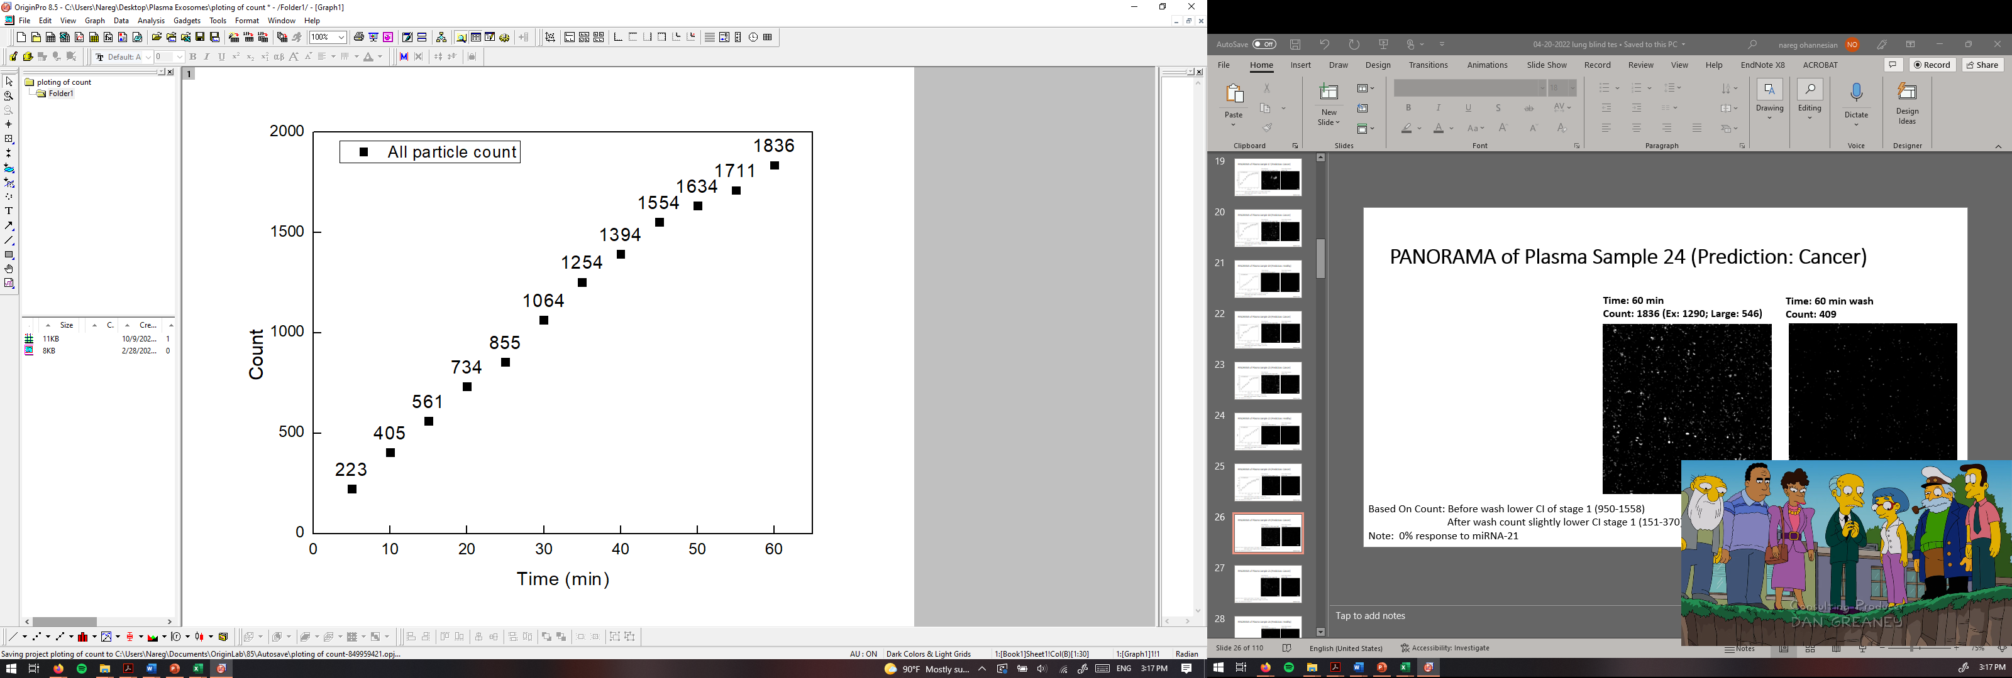
PANORAMA of Plasma Sample 24 (Prediction: Cancer)
Time: 60 min
Count: 1836 (Ex: 1290; Large: 546)
Time: 60 min wash
Count: 409
Based On Count: Before wash lower CI of stage 1 (950-1558)
After wash count slightly lower CI stage 1 (151-370)
Note: 0% response to miRNA-21
Scale bar: 10 µm

Slide 3
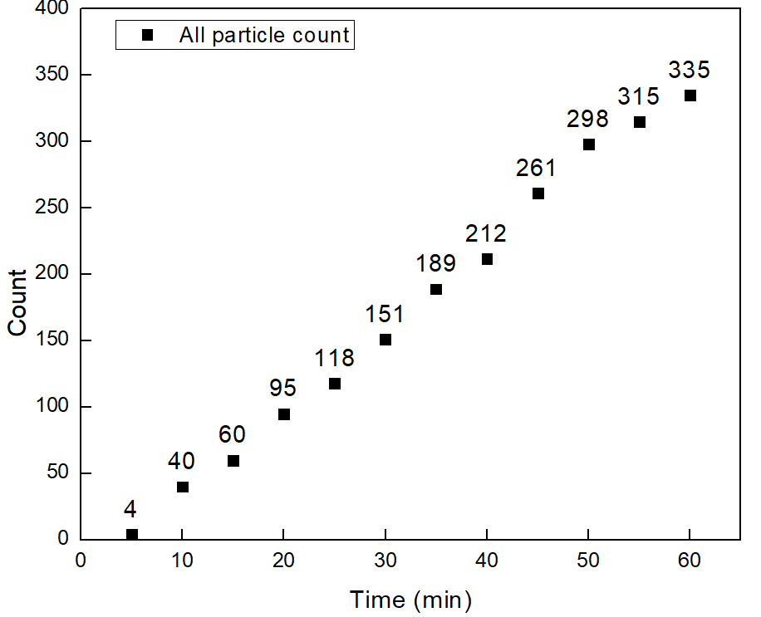
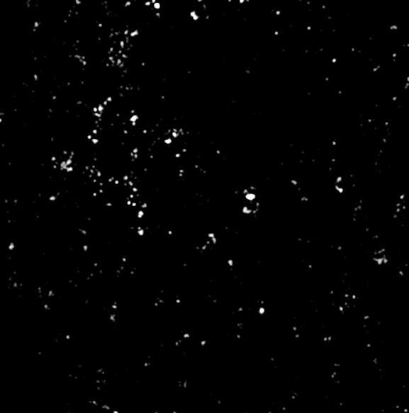

PANORAMA of Plasma Sample 25 (Prediction: Cancer)
Time: 60 min
Count: 335 (Ex: 281; Large: 54)
Time: 60 min wash
Count: 186
Based On Count: Before wash lower CI of stage 1 (950-1558)
After wash count matches CI stage 1 (151-370)
Note: 0% response to miRNA-21
Scale bar: 10 µm

Slide 4
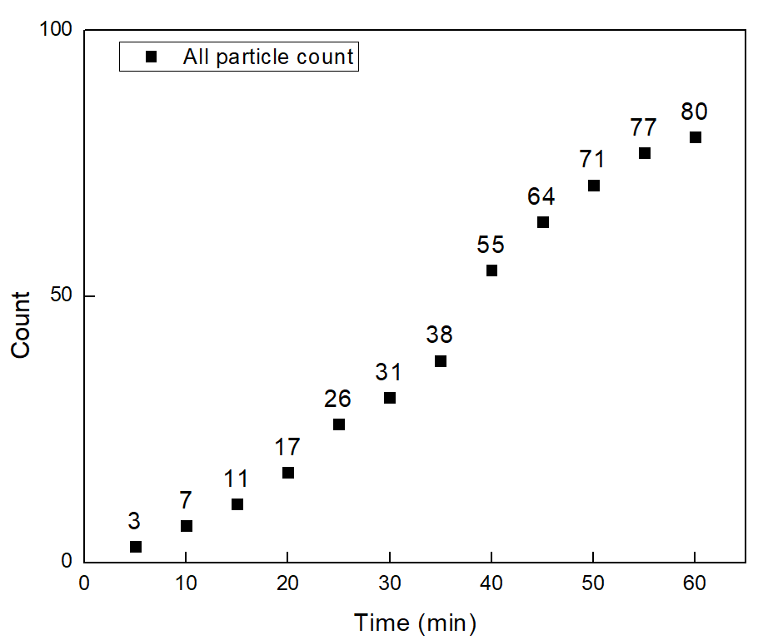
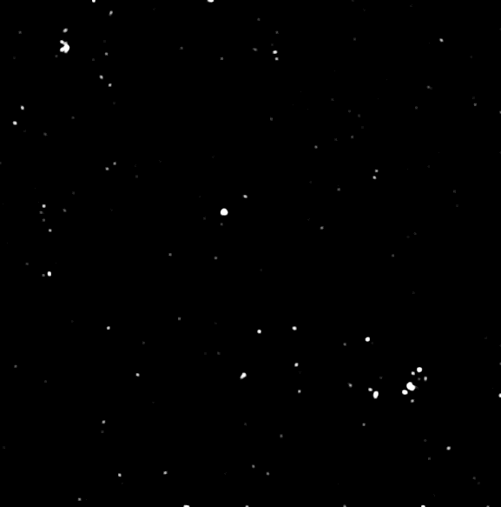

PANORAMA of Plasma Sample 26 (Prediction: Healthy)
Time: 60 min
Count: 80 (Ex: 65; Large:15)
Time: 60 min wash
Count: 20
Based On Count: Before wash count lower CI Healthy (214-263)
After wash count lower CI Healthy (24-34)
Note: 0 % response to miRNA-21
Scale bar: 10 µm

Slide 5
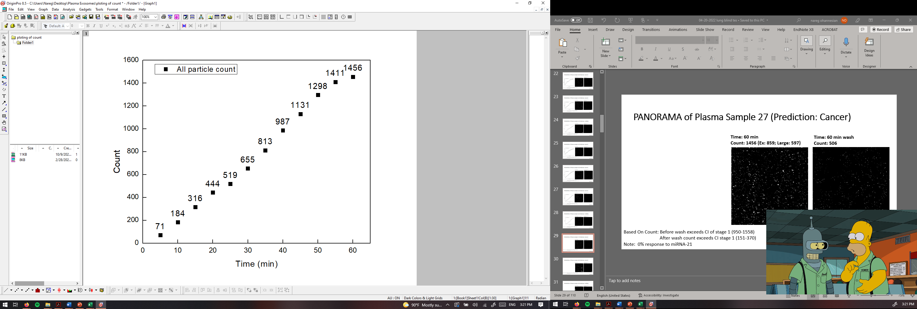

PANORAMA of Plasma Sample 27 (Prediction: Cancer)
Time: 60 min
Count: 1456 (Ex: 859; Large: 597)
Time: 60 min wash
Count: 506
Based On Count: Before wash exceeds CI of stage 1 (950-1558)
After wash count exceeds CI stage 1 (151-370)
Note: 0% response to miRNA-21
Scale bar: 10 µm

Slide 6
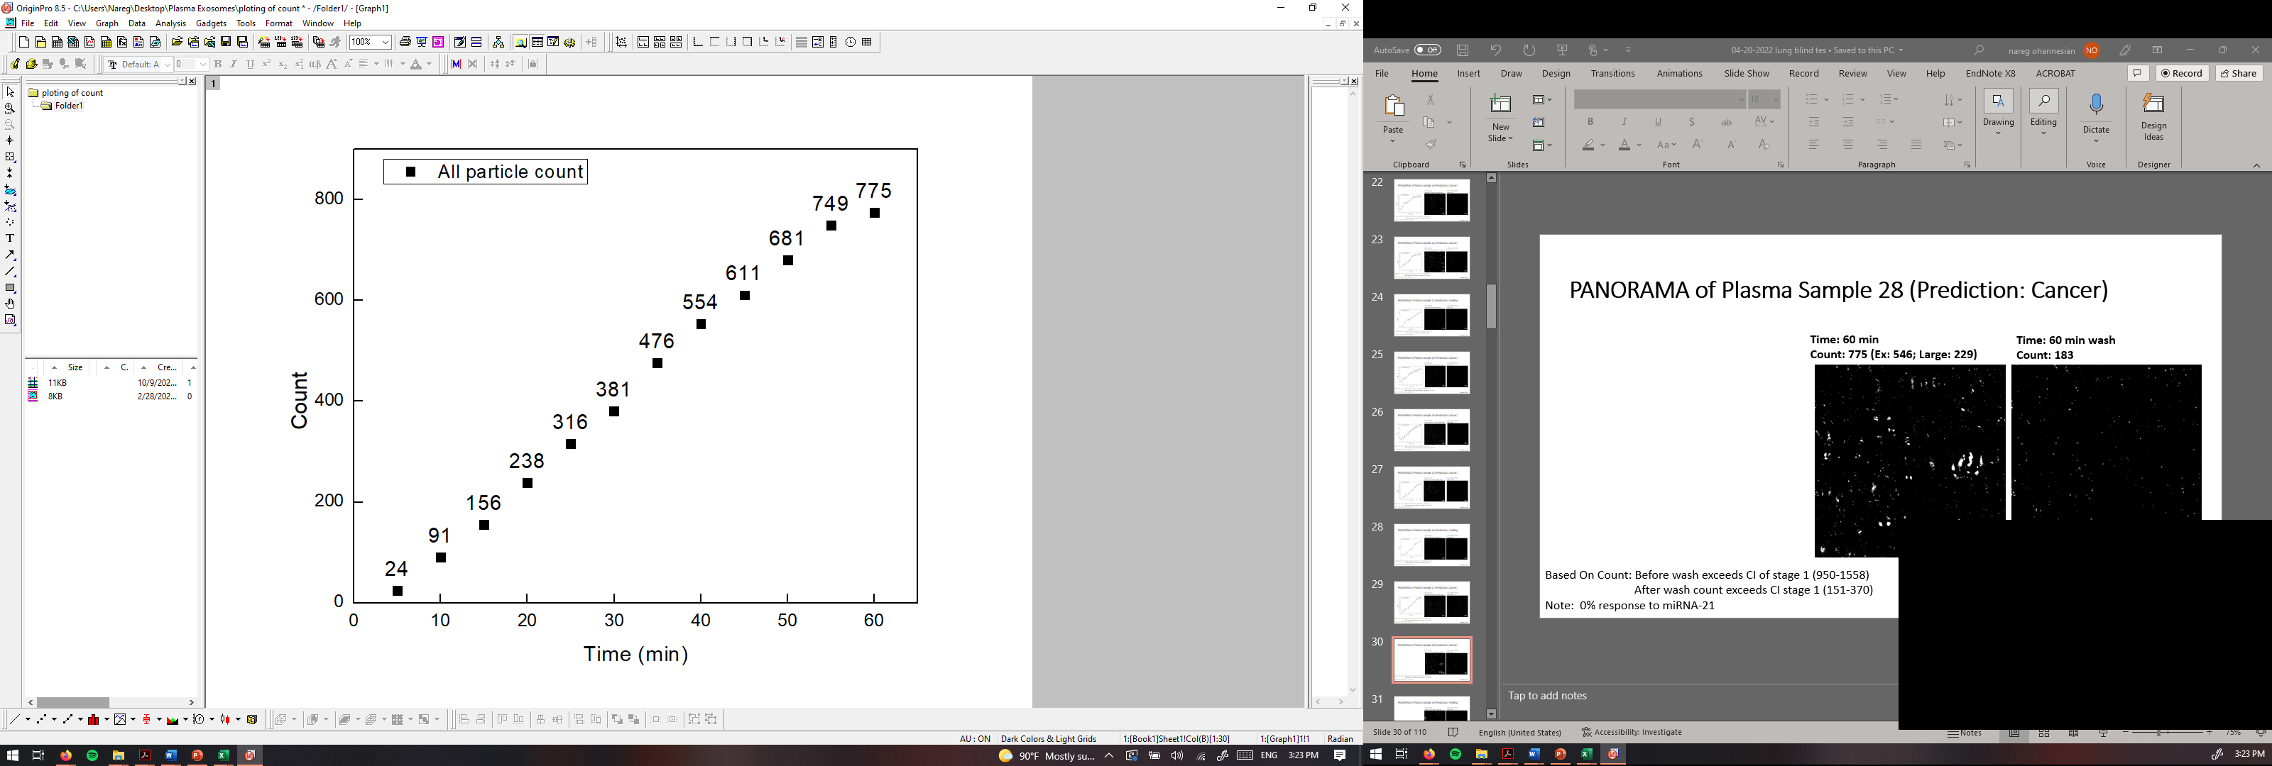

PANORAMA of Plasma Sample 28 (Prediction: Cancer)
Time: 60 min
Count: 775 (Ex: 546; Large: 229)
Time: 60 min wash
Count: 183
Based On Count: Before wash exceeds CI of stage 1 (950-1558)
After wash count exceeds CI stage 1 (151-370)
Note: 0% response to miRNA-21
Scale bar: 10 µm

Slide 7
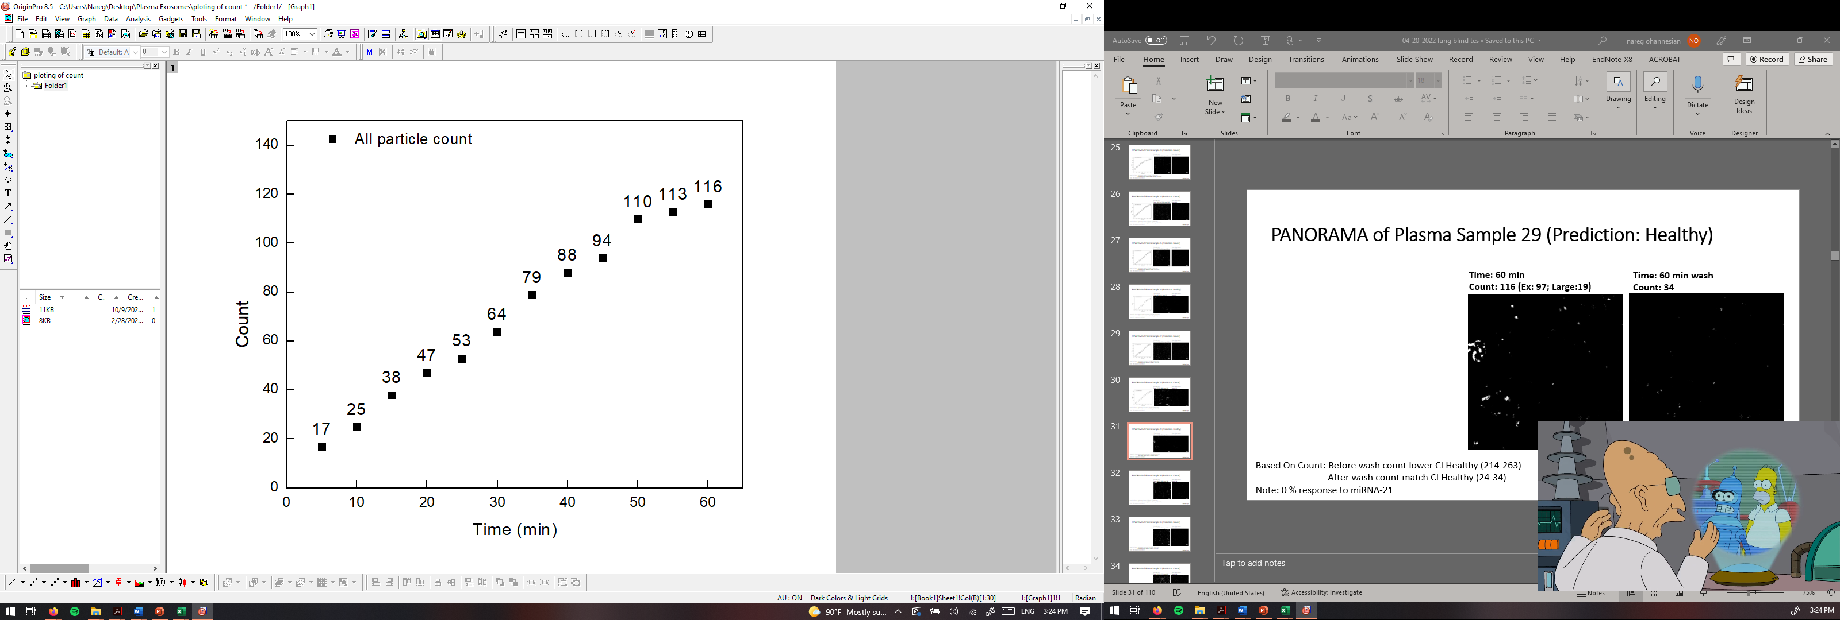
PANORAMA of Plasma Sample 29 (Prediction: Healthy)
Time: 60 min
Count: 116 (Ex: 97; Large:19)
Time: 60 min wash
Count: 34
Based On Count: Before wash count lower CI Healthy (214-263)
After wash count match CI Healthy (24-34)
Note: 0 % response to miRNA-21
Scale bar: 10 µm

Slide 8
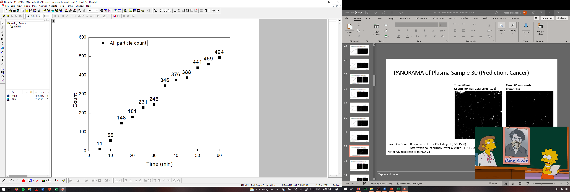
PANORAMA of Plasma Sample 30 (Prediction: Cancer)
Time: 60 min
Count: 494 (Ex: 296; Large: 198)
Time: 60 min wash
Count: 134
Based On Count: Before wash lower CI of stage 1 (950-1558)
After wash count slightly lower CI stage 1 (151-370)
Note: 0% response to miRNA-21
Scale bar: 10 µm

Slide 9
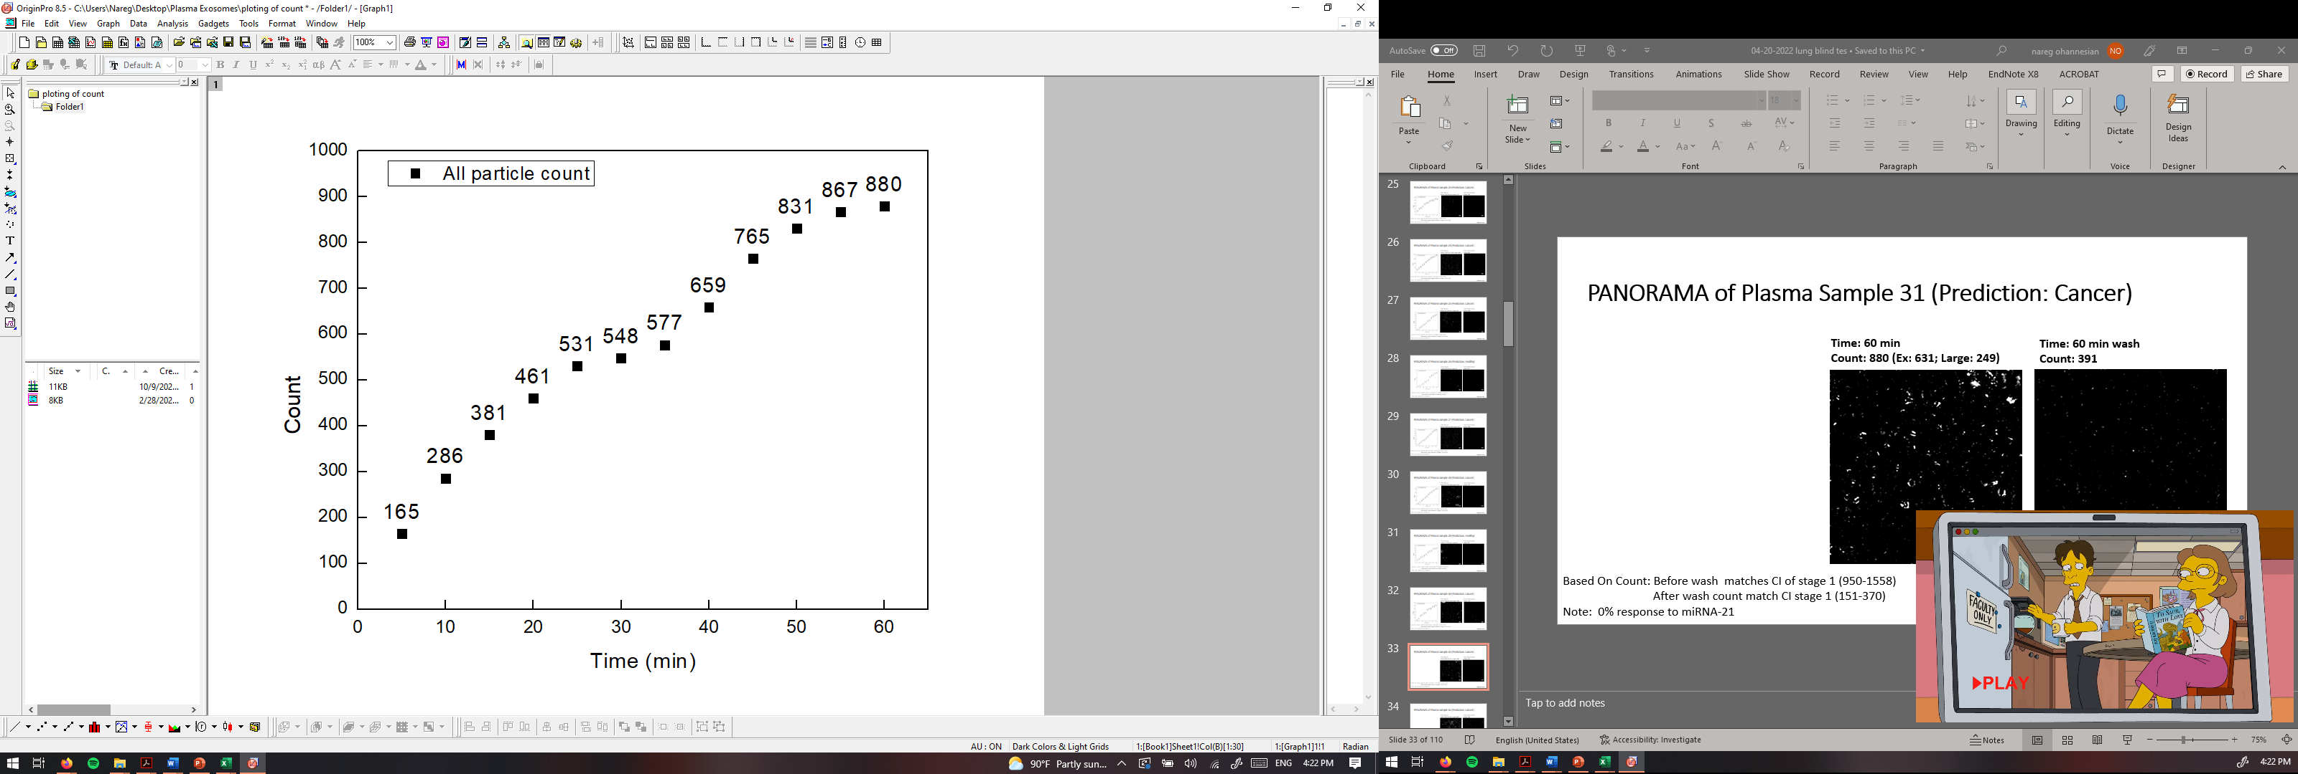
PANORAMA of Plasma Sample 31 (Prediction: Cancer)
Time: 60 min
Count: 880 (Ex: 631; Large: 249)
Time: 60 min wash
Count: 391
Based On Count: Before wash matches CI of stage 1 (950-1558)
After wash count match CI stage 1 (151-370)
Note: 0% response to miRNA-21
Scale bar: 10 µm

Slide 10
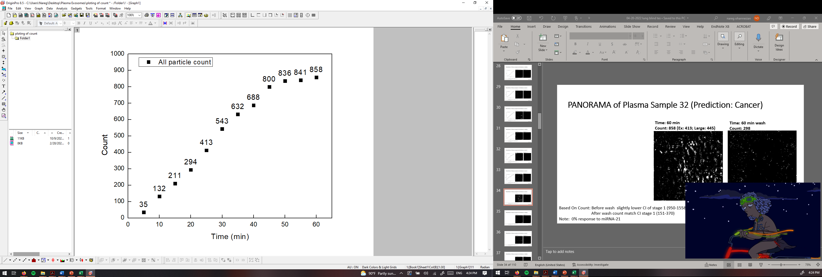
PANORAMA of Plasma Sample 32 (Prediction: Cancer)
Time: 60 min
Count: 858 (Ex: 413; Large: 445)
Time: 60 min wash
Count: 298
Based On Count: Before wash slightly lower CI of stage 1 (950-1558)
After wash count match CI stage 1 (151-370)
Note: 0% response to miRNA-21
Scale bar: 10 µm

Slide 11
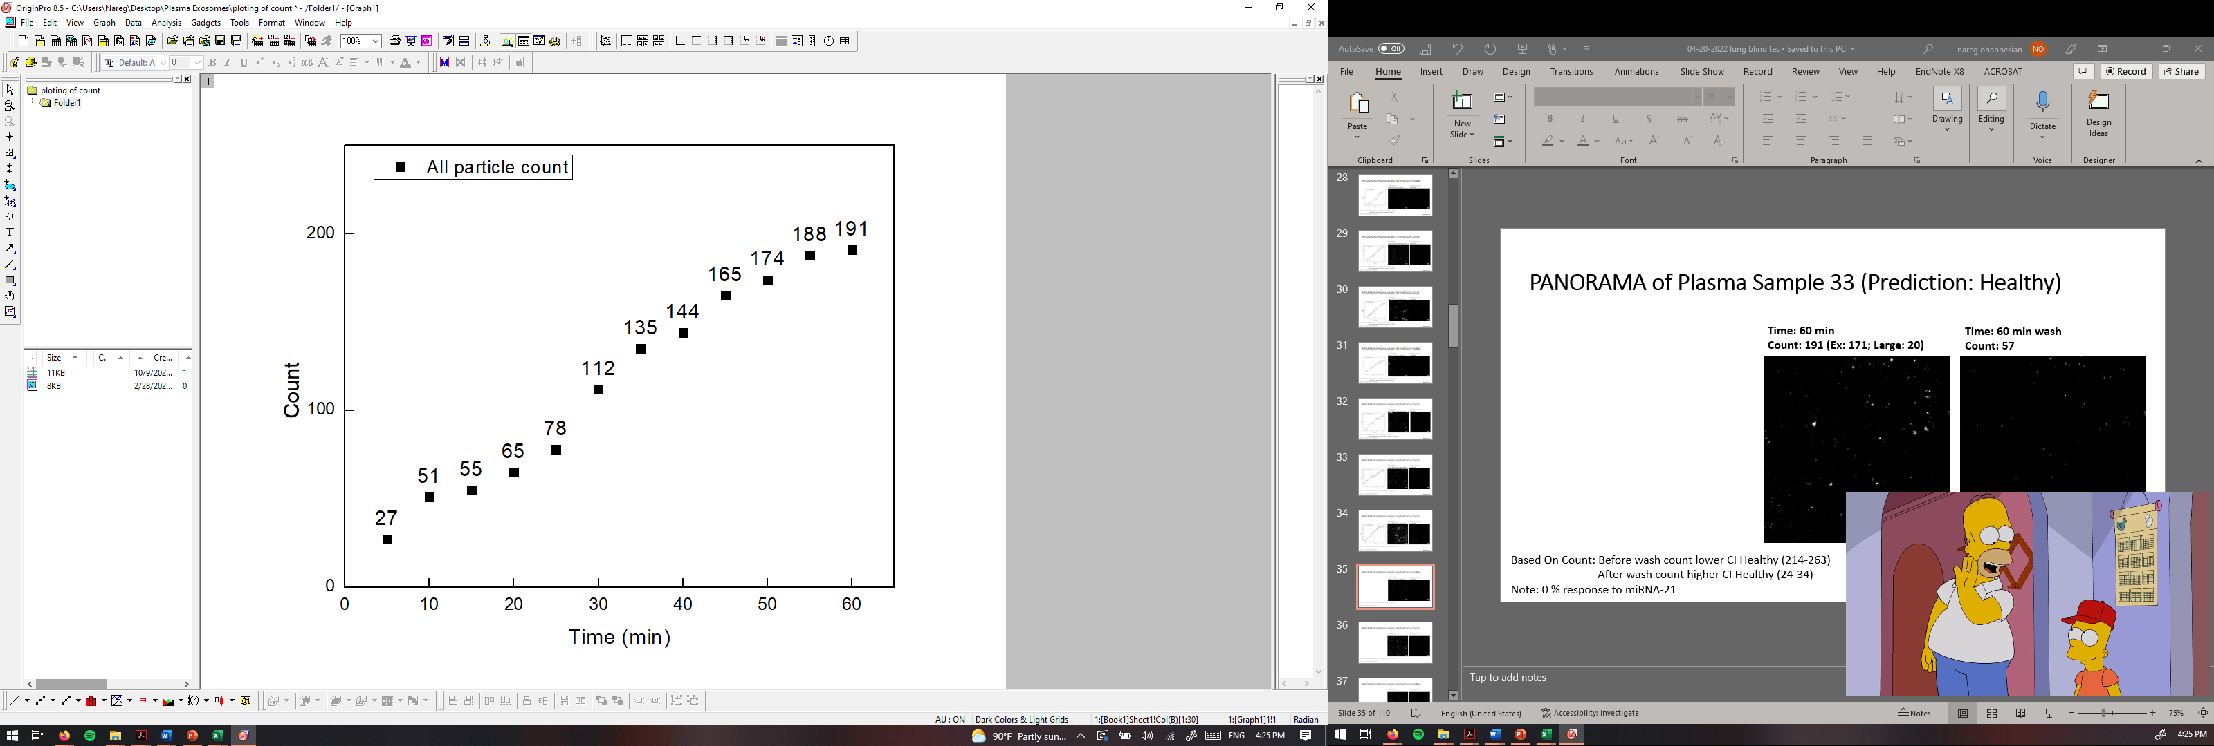
PANORAMA of Plasma Sample 33 (Prediction: Healthy)
Time: 60 min
Count: 191 (Ex: 171; Large: 20)
Time: 60 min wash
Count: 57
Based On Count: Before wash count lower CI Healthy (214-263)
After wash count higher CI Healthy (24-34)
Note: 0 % response to miRNA-21
Scale bar: 10 µm

Slide 12
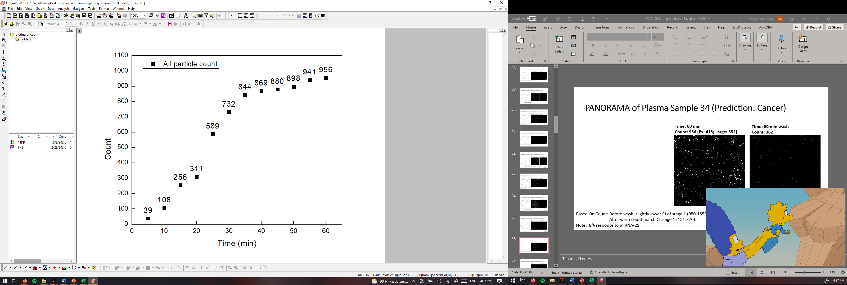
PANORAMA of Plasma Sample 34 (Prediction: Cancer)
Time: 60 min
Count: 956 (Ex: 413; Large: 352)
Time: 60 min wash
Count: 362
Based On Count: Before wash slightly lower CI of stage 1 (950-1558)
After wash count match CI stage 1 (151-370)
Note: 8% response to miRNA-21
Scale bar: 10 µm

Slide 13
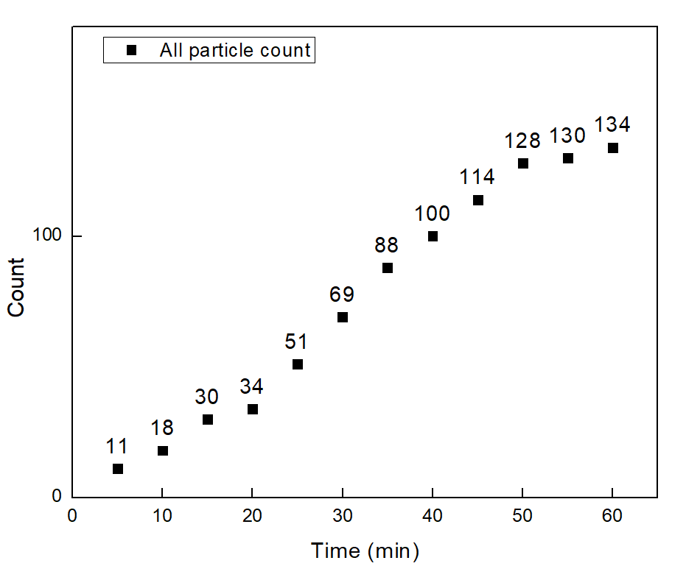
PANORAMA of Plasma Sample 35 (Prediction: Healthy)
Time: 60 min
Count: 134 (Ex: 103; Large: 31)
Time: 60 min wash
Count: 40
Based On Count: Before wash count lower CI Healthy (214-263)
After wash count higher CI Healthy (24-34)
Note: 0 % response to miRNA-21
Scale bar: 10 µm

Slide 14
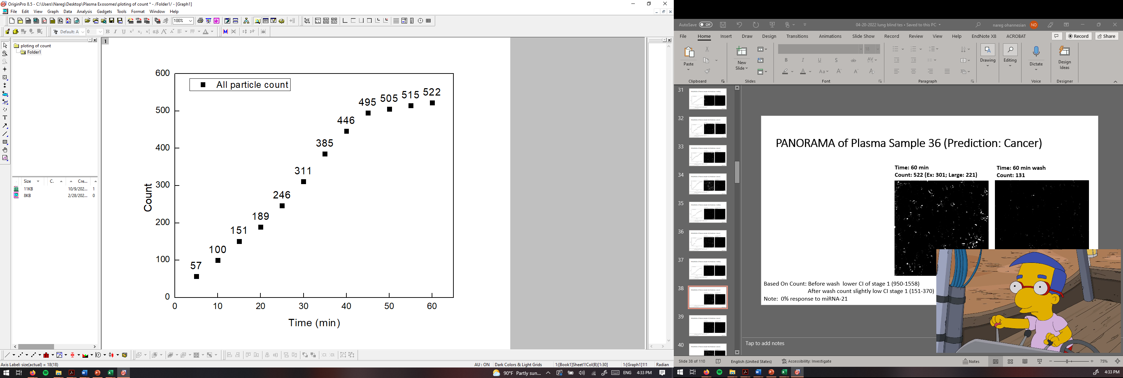
PANORAMA of Plasma Sample 36 (Prediction: Cancer)
Time: 60 min
Count: 522 (Ex: 301; Large: 221)
Time: 60 min wash
Count: 131
Based On Count: Before wash lower CI of stage 1 (950-1558)
After wash count slightly low CI stage 1 (151-370)
Note: 0% response to miRNA-21
Scale bar: 10 µm

Slide 15
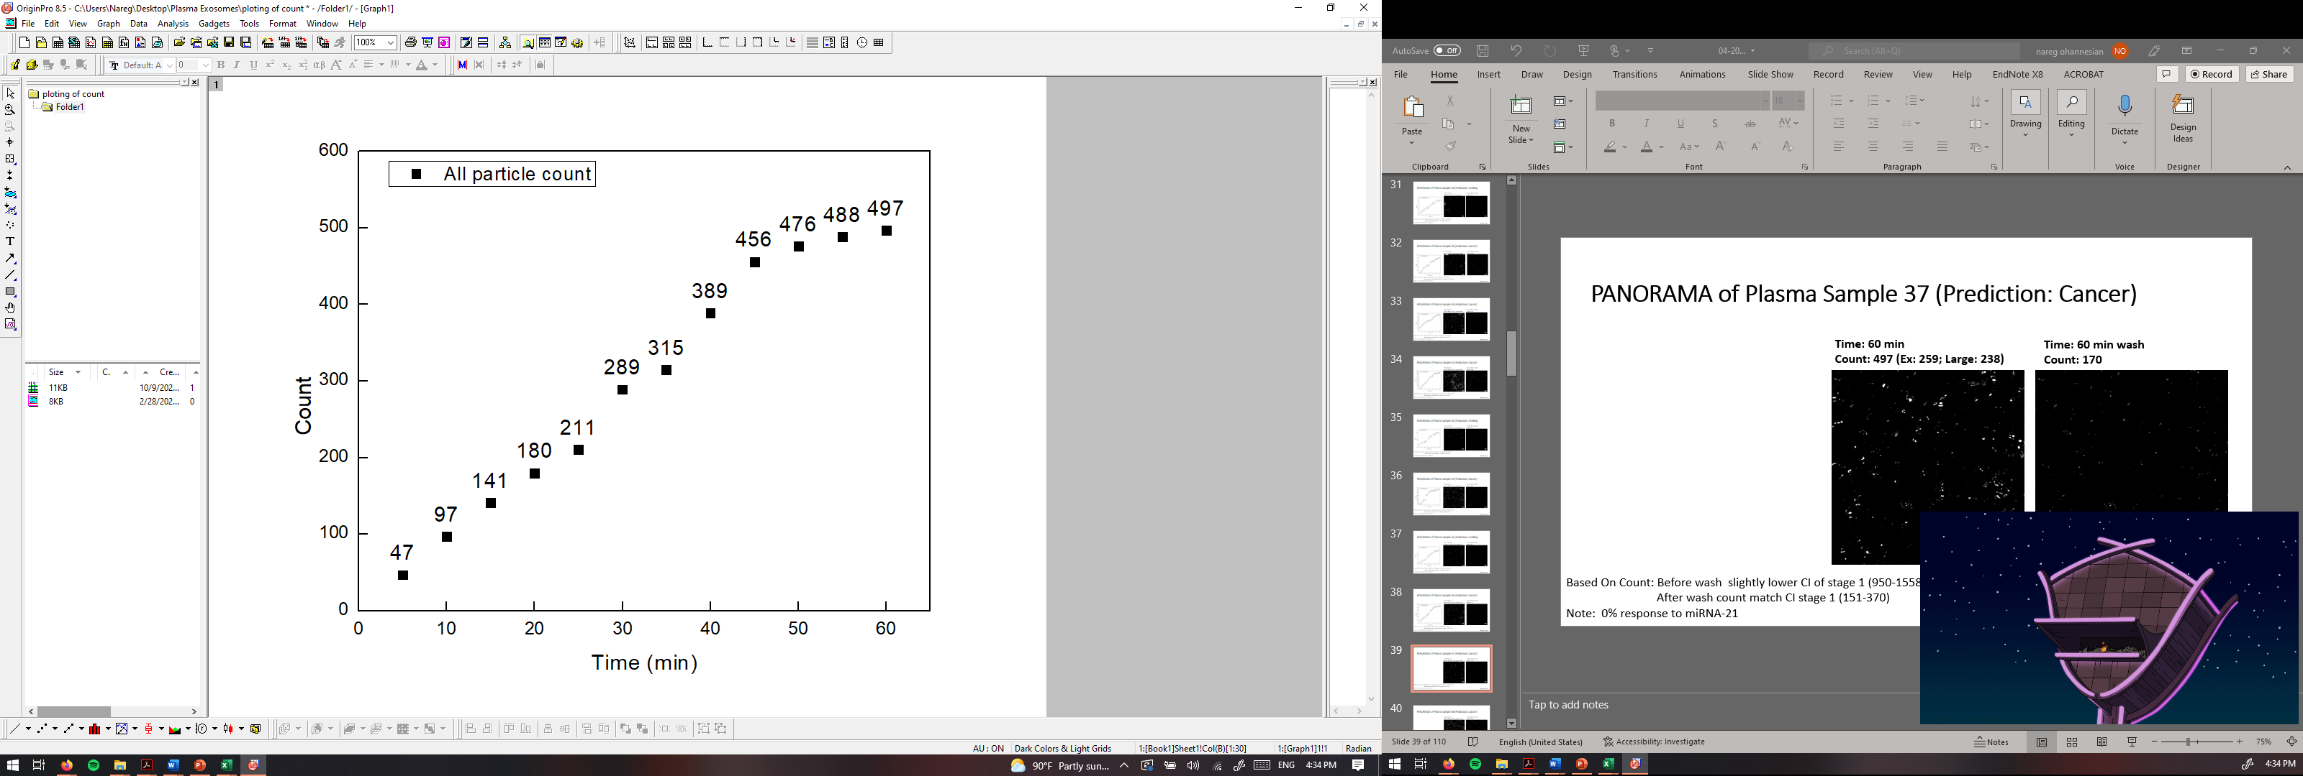
PANORAMA of Plasma Sample 37 (Prediction: Cancer)
Time: 60 min
Count: 497 (Ex: 259; Large: 238)
Time: 60 min wash
Count: 170
Based On Count: Before wash slightly lower CI of stage 1 (950-1558)
After wash count match CI stage 1 (151-370)
Note: 0% response to miRNA-21
Scale bar: 10 µm

Slide 16
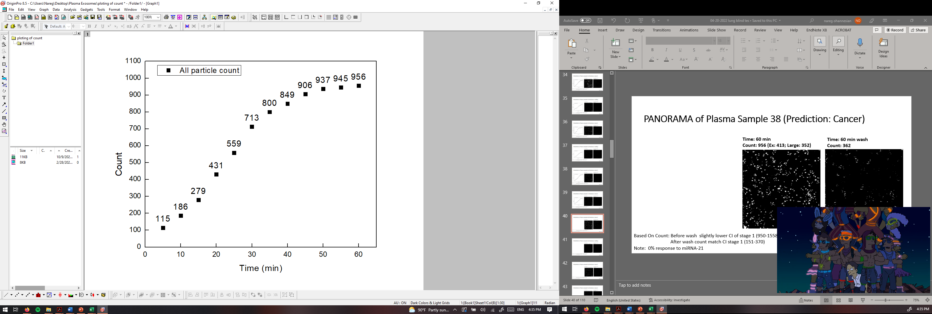

PANORAMA of Plasma Sample 38 (Prediction: Cancer)
Time: 60 min
Count: 956 (Ex: 413; Large: 352)
Time: 60 min wash
Count: 362
Based On Count: Before wash slightly lower CI of stage 1 (950-1558)
After wash count match CI stage 1 (151-370)
Note: 0% response to miRNA-21
Scale bar: 10 µm

Slide 17
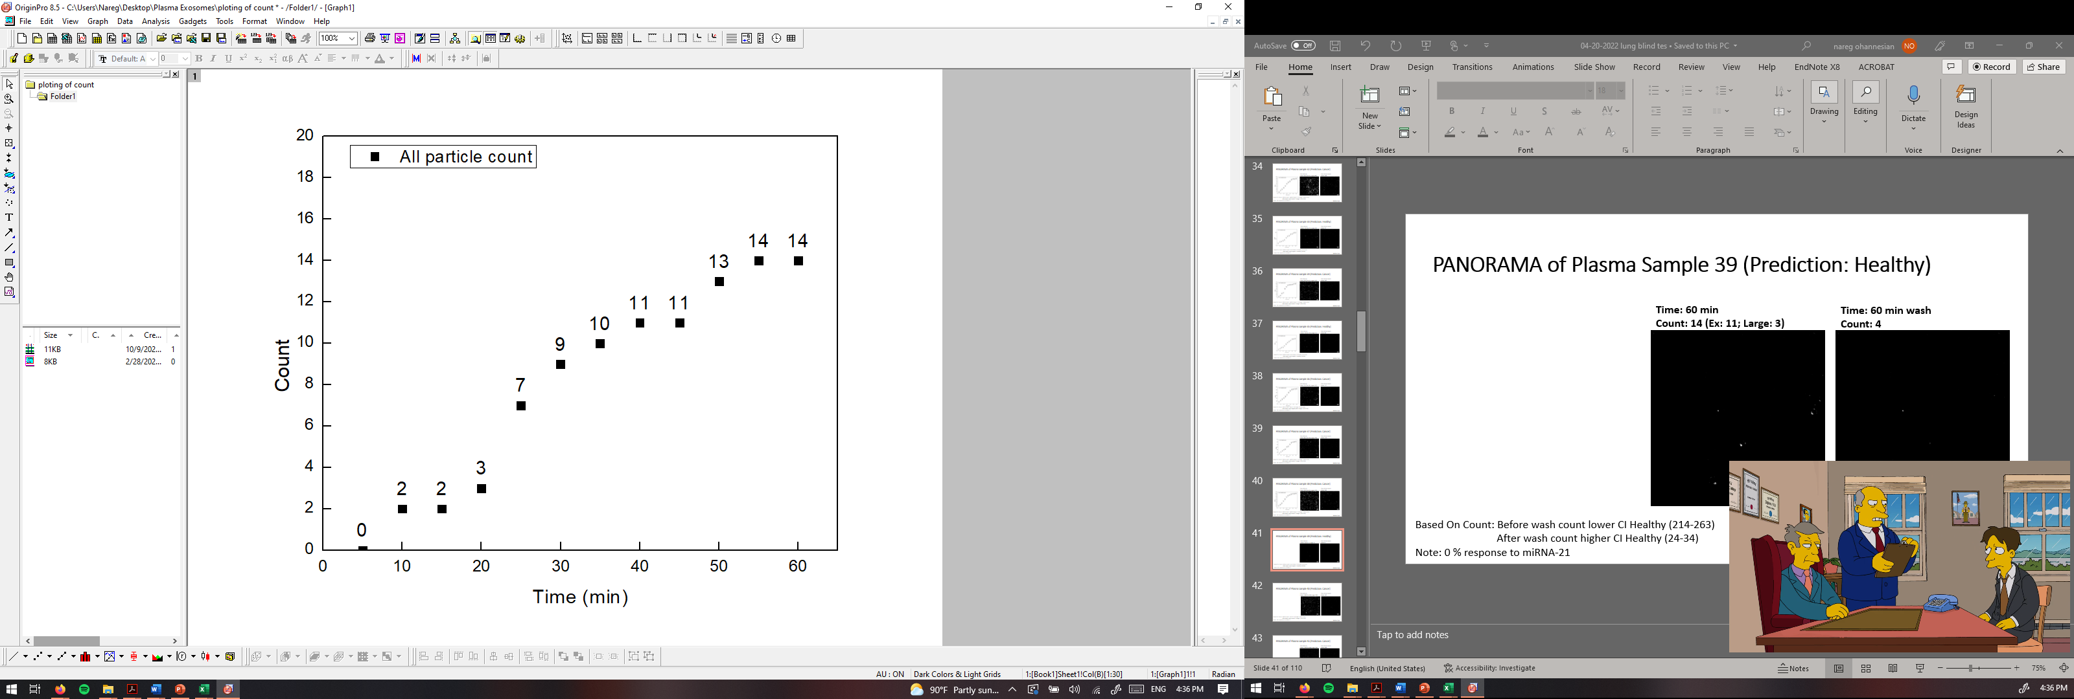
PANORAMA of Plasma Sample 39 (Prediction: Healthy)
Time: 60 min
Count: 14 (Ex: 11; Large: 3)
Time: 60 min wash
Count: 4
Based On Count: Before wash count lower CI Healthy (214-263)
After wash count higher CI Healthy (24-34)
Note: 0 % response to miRNA-21
Scale bar: 10 µm

Slide 18
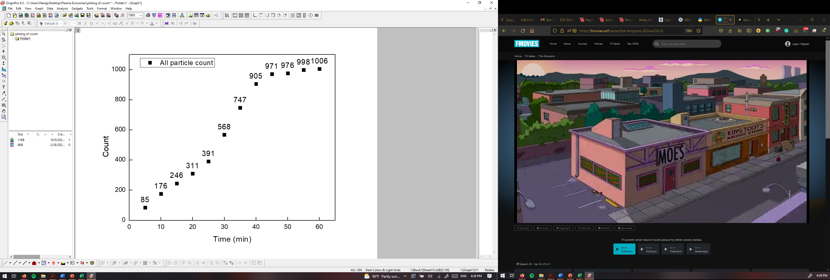

PANORAMA of Plasma Sample 40 (Prediction: Cancer)
Time: 60 min
Count: 1006 (Ex: 628; Large: 378)
Time: 60 min wash
Count: 187
Based On Count: Before wash match CI of stage 1 (950-1558)
After wash count match CI stage 1 (151-370)
Note: 0% response to miRNA-21
Scale bar: 10 µm

Slide 19

PANORAMA of Plasma Sample 41 (Prediction: Cancer)
Time: 60 min
Count: 1204 (Ex: 966; Large: 238)
Time: 60 min wash
Count: 266
Based On Count: Before wash count match CI of stage 1 (950-1558)
After wash count match CI stage 1 (151-370)
Note: 0% response to miRNA-21
Scale bar: 10 µm

Slide 20
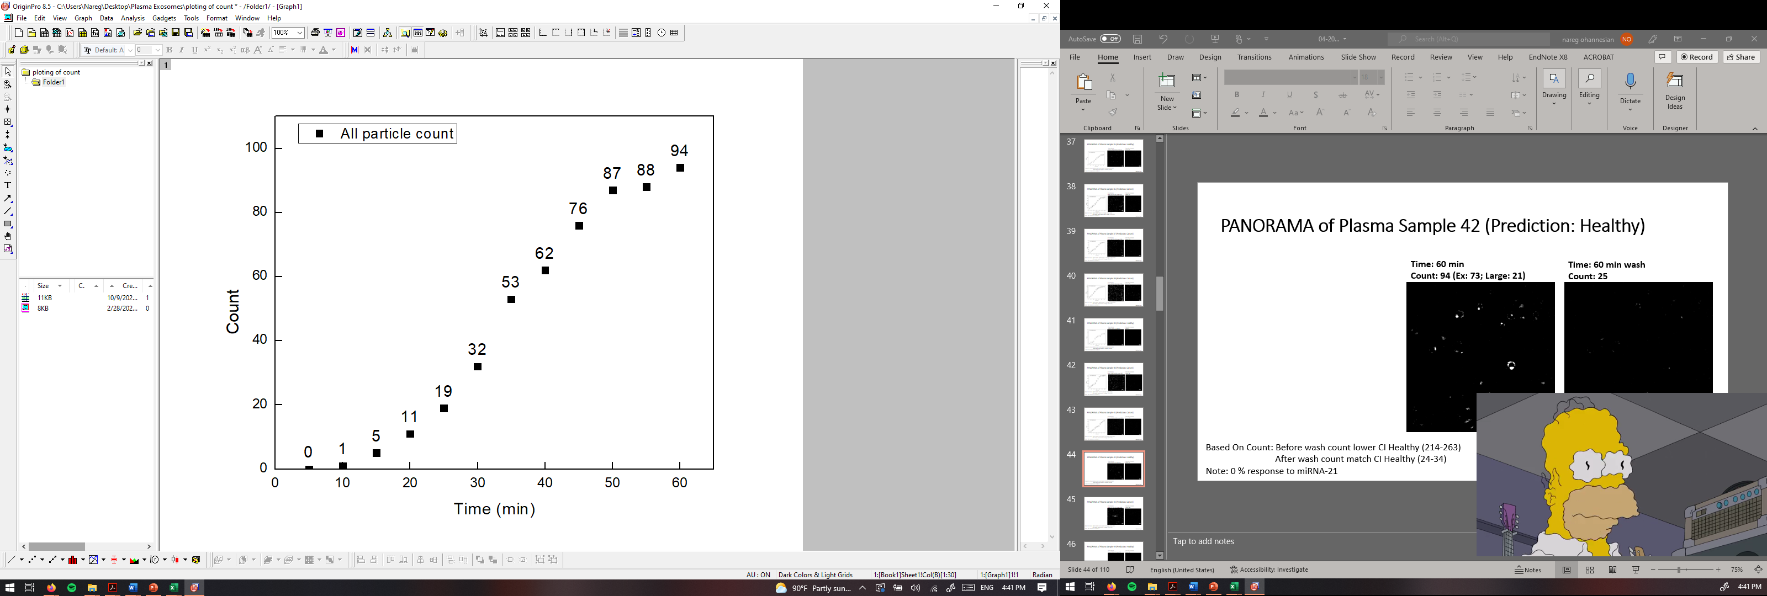
PANORAMA of Plasma Sample 42 (Prediction: Healthy)
Time: 60 min
Count: 94 (Ex: 73; Large: 21)
Time: 60 min wash
Count: 25
Based On Count: Before wash count lower CI Healthy (214-263)
After wash count match CI Healthy (24-34)
Note: 0 % response to miRNA-21
Scale bar: 10 µm

Slide 21
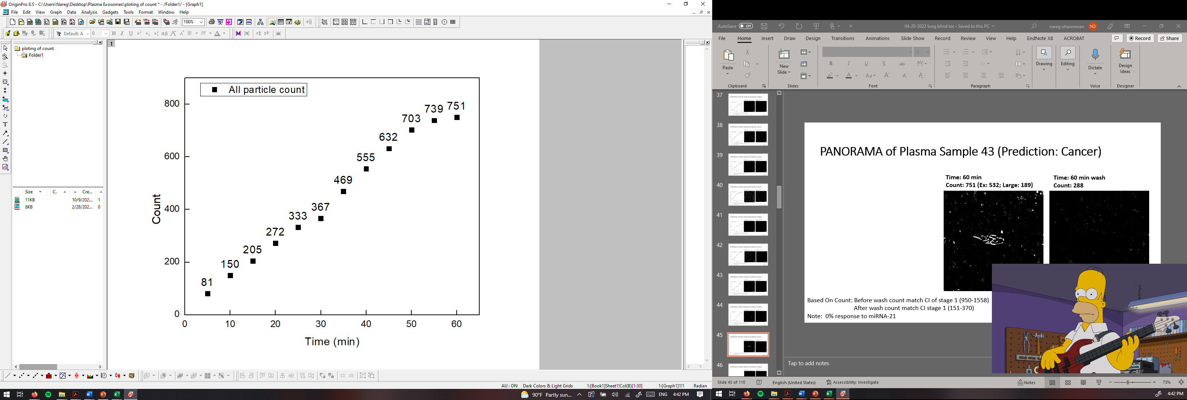
PANORAMA of Plasma Sample 43 (Prediction: Cancer)
Time: 60 min
Count: 751 (Ex: 532; Large: 189)
Time: 60 min wash
Count: 288
Based On Count: Before wash count match CI of stage 1 (950-1558)
After wash count match CI stage 1 (151-370)
Note: 0% response to miRNA-21
Scale bar: 10 µm

Slide 22
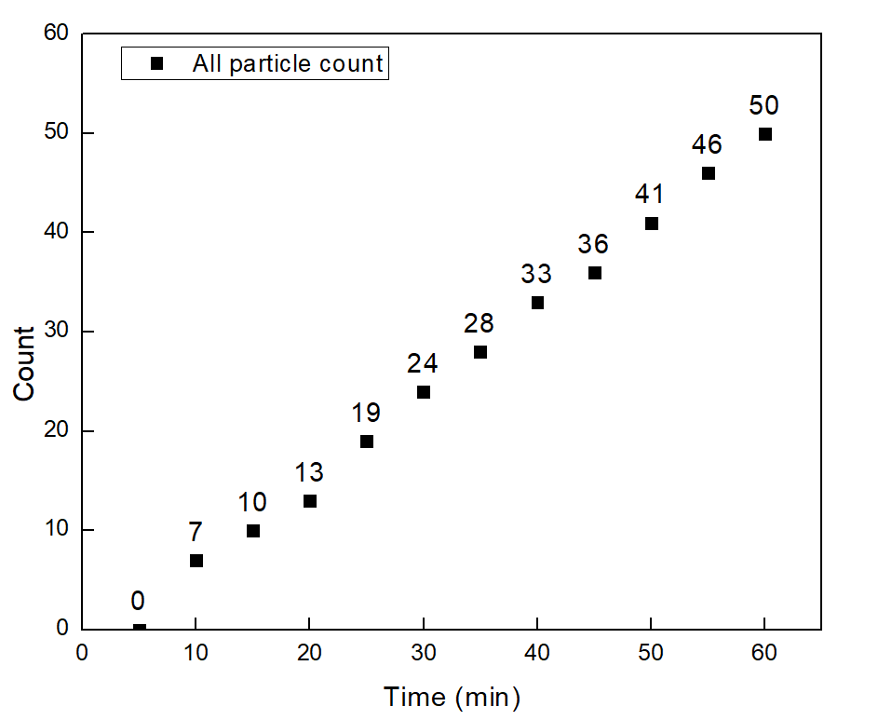

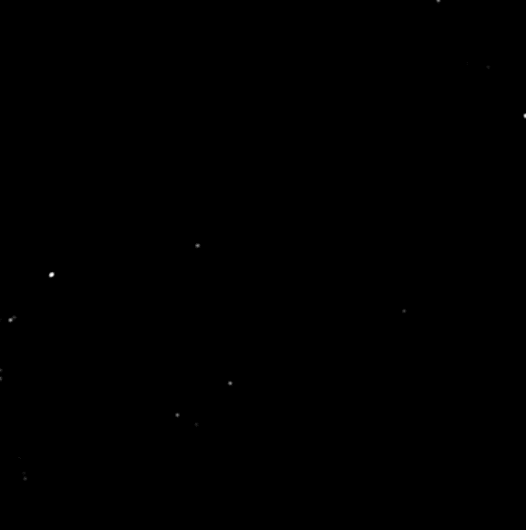
PANORAMA of Plasma Sample 44 (Prediction: Healthy)
Time: 60 min
Count: 50 (Ex: 31; Large: 19)
Time: 60 min wash
Count: 10
Based On Count: Before wash count lower CI Healthy (214-263)
After wash count higher CI Healthy (24-34)
Note: 0 % response to miRNA-21
Scale bar: 10 µm

Slide 23
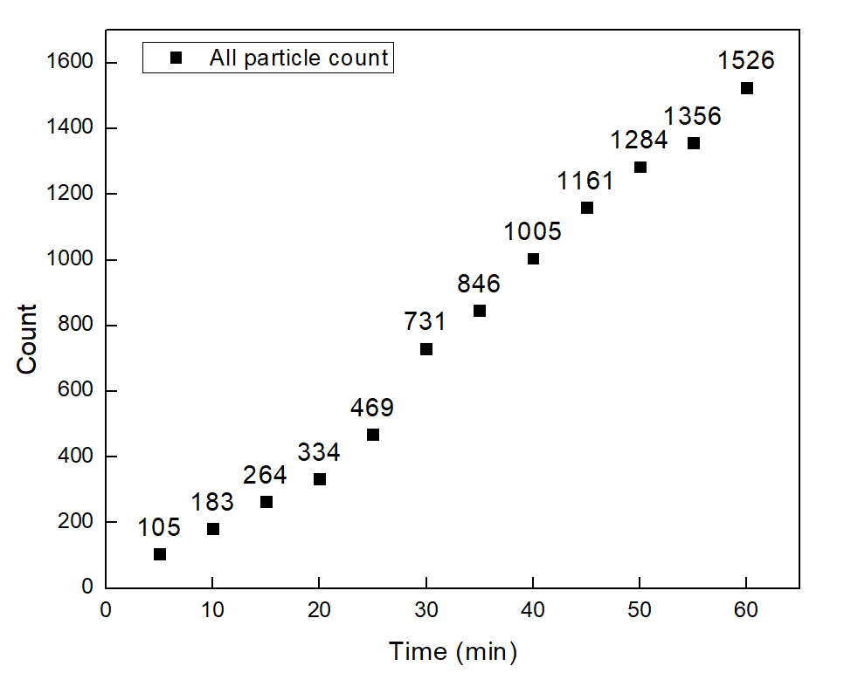


PANORAMA of Plasma Sample 45 (Prediction: Cancer)
Time: 60 min
Count: 1526 (Ex: 1186; Large: 340)
Time: 60 min wash
Count: 362
Based On Count: Before wash count match CI of stage 1 (950-1558)
After wash count match CI stage 1 (151-370)
Note: 0% response to miRNA-21
Scale bar: 10 µm

Slide 24
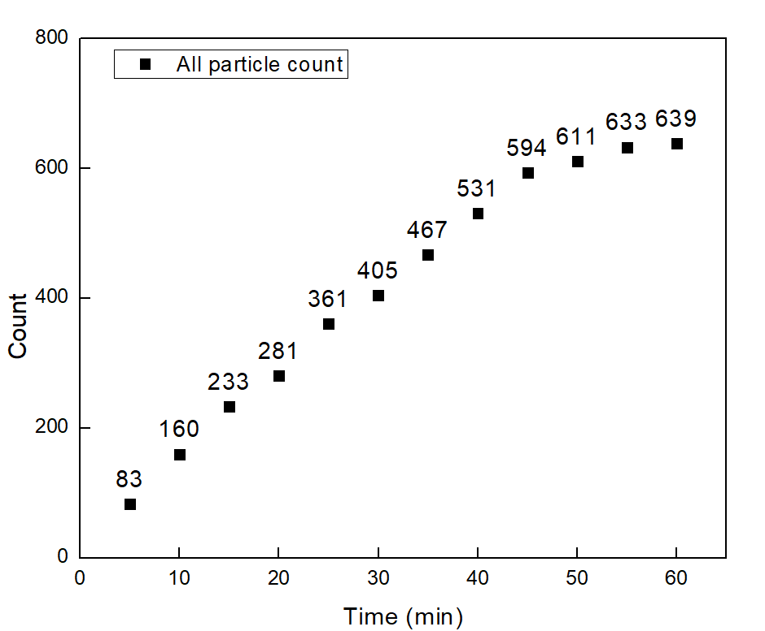
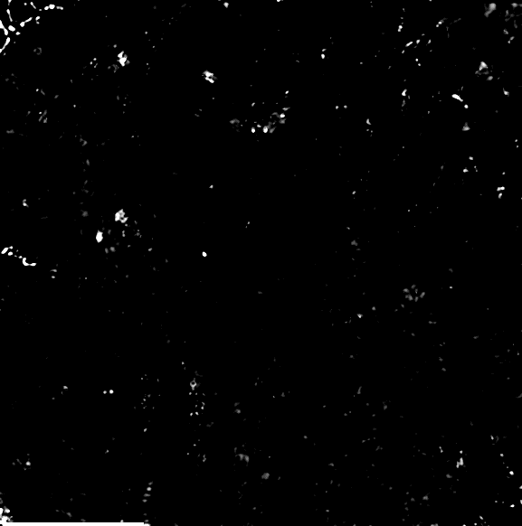

PANORAMA of Plasma Sample 46 (Prediction: Cancer)
Time: 60 min
Count: 639 (Ex: 539; Large: 100)
Time: 60 min wash
Count: 195
Based On Count: Before wash count lower CI of stage 1 (950-1558)
After wash count match CI stage 1 (151-370)
Note: 0% response to miRNA-21
Scale bar: 10 µm

Slide 25
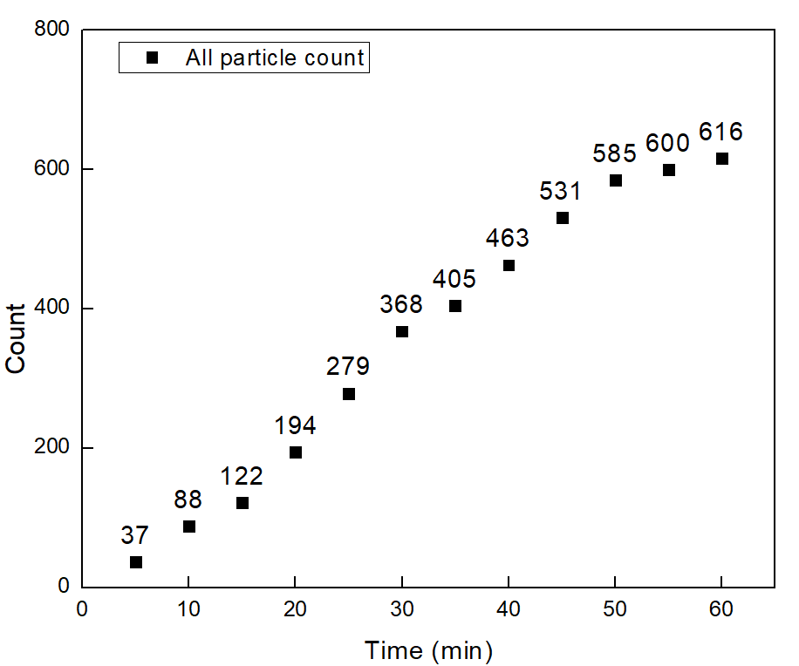


PANORAMA of Plasma Sample 47 (Prediction: Cancer)
Time: 60 min
Count: 616 (Ex: 465; Large: 151)
Time: 60 min wash
Count: 181
Based On Count: Before wash count match CI of stage 1 (950-1558)
After wash count match CI stage 1 (151-370)
Note: 0% response to miRNA-21
Scale bar: 10 µm

Slide 26
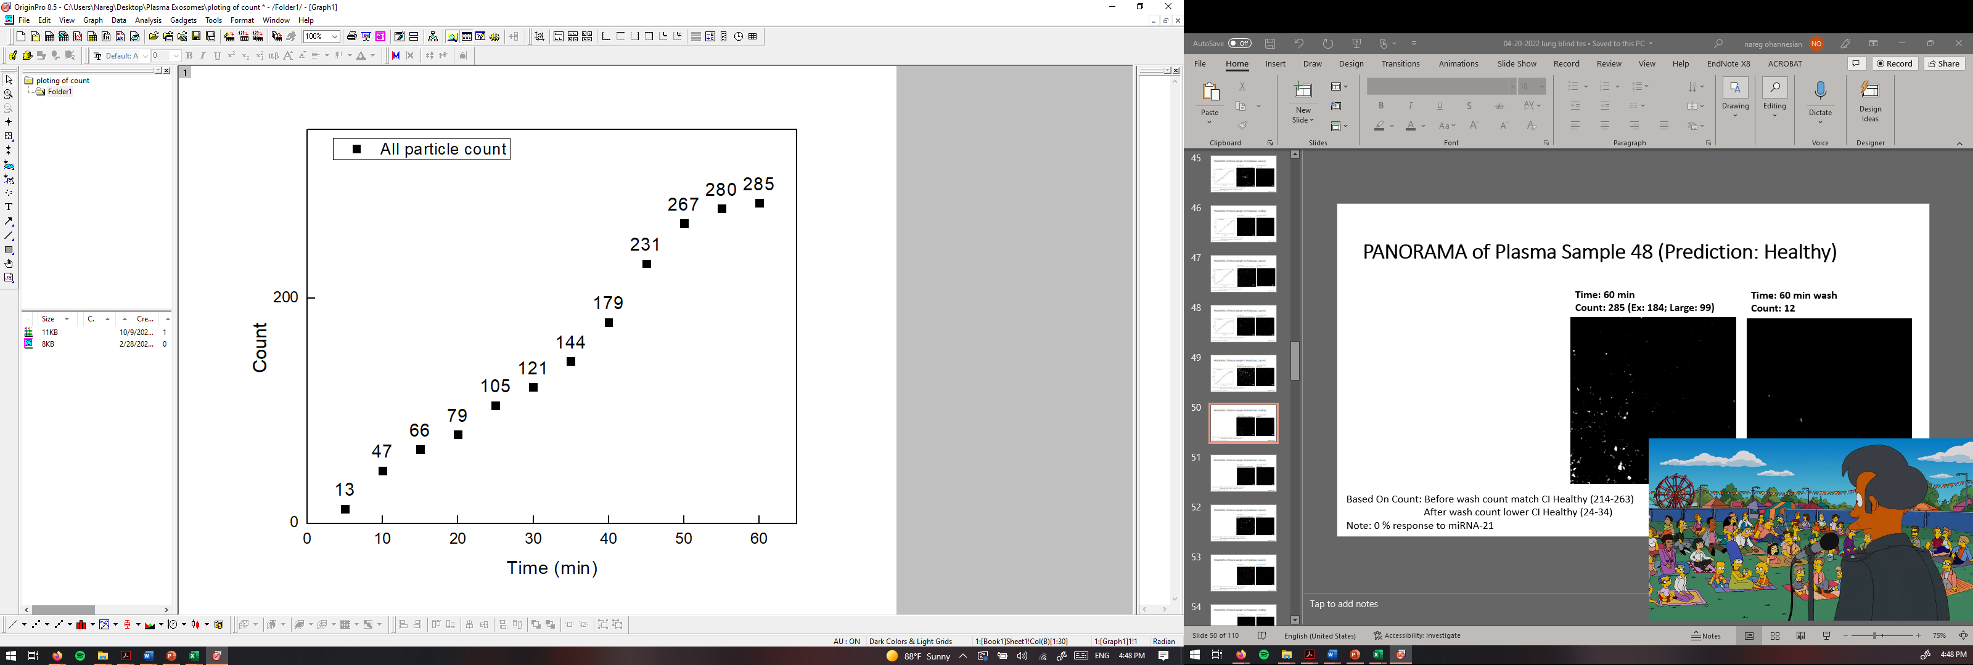
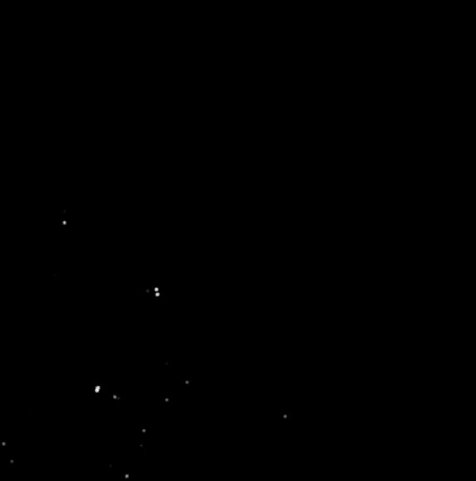
PANORAMA of Plasma Sample 48 (Prediction: Healthy)
Time: 60 min
Count: 285 (Ex: 184; Large: 99)
Time: 60 min wash
Count: 12
Based On Count: Before wash count match CI Healthy (214-263)
After wash count lower CI Healthy (24-34)
Note: 0 % response to miRNA-21
Scale bar: 10 µm

Slide 27
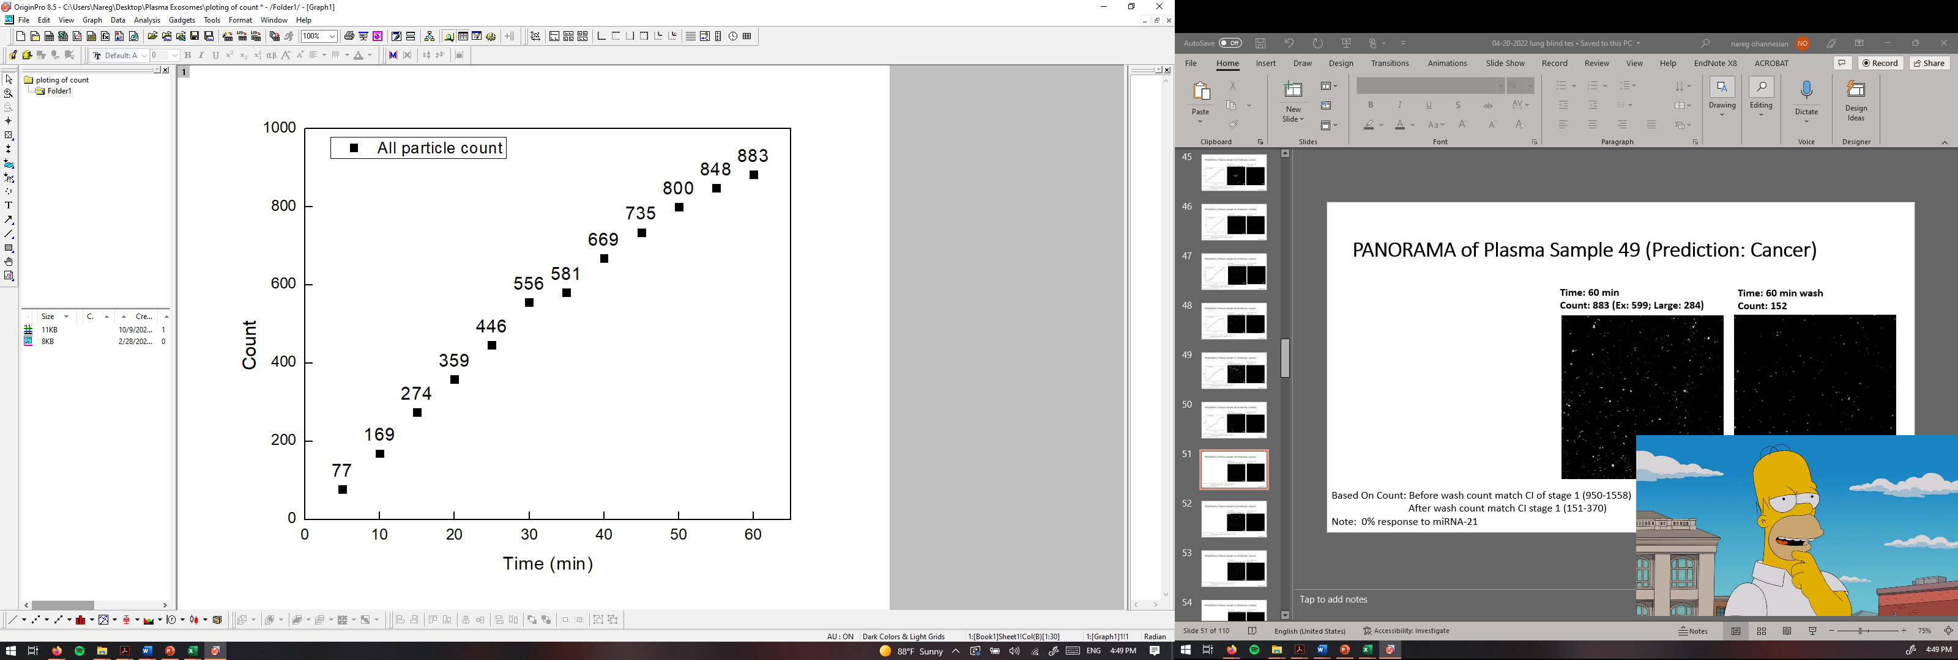

PANORAMA of Plasma Sample 49 (Prediction: Cancer)
Time: 60 min
Count: 883 (Ex: 599; Large: 284)
Time: 60 min wash
Count: 152
Based On Count: Before wash count match CI of stage 1 (950-1558)
After wash count match CI stage 1 (151-370)
Note: 0% response to miRNA-21
Scale bar: 10 µm

